Slide 1
DDCA | DIGITAL LOGIC PROJECT
Design and Simulation of a Digital Data Transmission Error Detection System
DATA → CHECK
1011 → OK
Even-parity detection with controllable error injection
BOGA SHASHANK 2620040175
AKHILESH GOUD 2620040176
SRIJAN SHAW 2620080002
Submitted By:
PROJECT PRESENTATION
01/10

Slide 2
Why error detection matters
01 • INTRODUCTION
Digital data is transmitted as bits.
A noisy or faulty channel can flip a bit—changing the information received. Error detection adds a check so the receiver can identify certain corruptions.
PROJECT SNAPSHOT
4-bit input data
Even-parity bit generated at sender
Switches inject deliberate bit flips
SENDER
CHANNEL
RECEIVER
Receiver outputs ERROR / NO_ERROR
1011
→
1001
→
FLAG
Core idea: compare the parity of the received word with the expected even-parity condition.
DDCA • DIGITAL DATA TRANSMISSION ERROR DETECTION
02/10

Slide 3
Problem statement
02 • PROBLEM
THE CHALLENGE
DESIGN BOUNDARY
A transmitted bit may change in transit. Without a check, the receiver may accept corrupted data.
This project uses one even-parity bit for a 4-bit data word.
It detects odd-numbered bit flips, but can miss even-numbered flips. It does not locate or correct an error.
Need: a simple digital circuit that detects parity mismatches and makes errors visible during simulation.
DDCA • DIGITAL DATA TRANSMISSION ERROR DETECTION
03/10

Slide 4
Project objectives
03 • OBJECTIVES
01
Generate
02
Transmit
Create even parity for a 4-bit input using XOR logic.
Pass data and parity through a modeled channel.
03
Inject
04
Detect
Use independent switches to flip selected bits.
Check received parity and drive status outputs.
05
Verify
Test normal, single-bit, parity-bit, and double-bit cases.
DDCA • DIGITAL DATA TRANSMISSION ERROR DETECTION
04/10

Slide 5
Existing approaches
04 • BACKGROUND
PARITY BIT
CHECKSUM
CRC
Adds one bit to indicate even/odd parity.
Computes a summary over a data block.
Uses polynomial-based remainder checking.
Simple hardware; limited coverage.
Useful for detecting many data changes.
More capable; requires more logic.
Project choice: parity keeps the circuit compact and makes XOR behavior easy to demonstrate.
DDCA • DIGITAL DATA TRANSMISSION ERROR DETECTION
05/10

Slide 6
Proposed system
05 • DESIGN
TRANSMITTER
ERROR CHANNEL
RECEIVER
➜
➜
D3…D0 → parity P
Ri = Di ⊕ Fi
XOR check → status
ERROR = R0 ⊕ R1 ⊕ R2 ⊕ R3 ⊕ PR | NO_ERROR = NOT(ERROR)
DDCA • DIGITAL DATA TRANSMISSION ERROR DETECTION
06/10

Slide 7
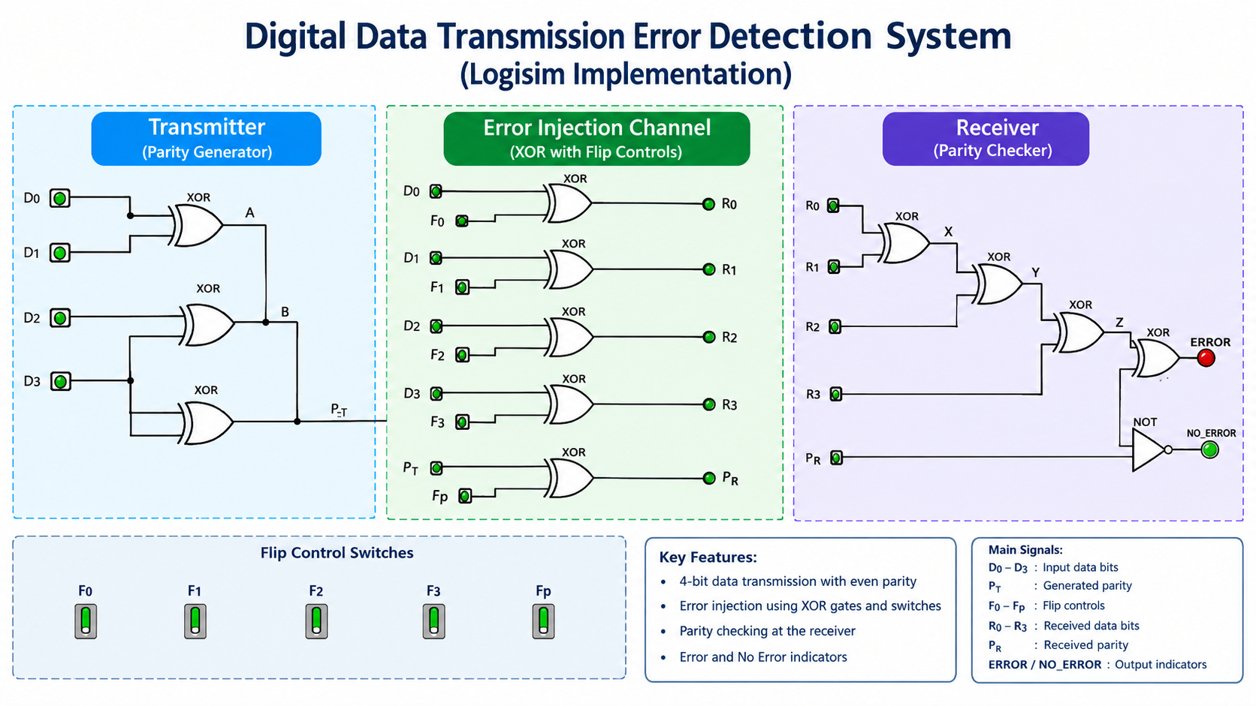
System architecture / block diagram
06 • ARCHITECTURE
DDCA • DIGITAL DATA TRANSMISSION ERROR DETECTION
07/10

Slide 8
Methodology & implementation
07 • IMPLEMENTATION
LOGIC EQUATIONS
BUILD SEQUENCE
Parity: P = D0 ⊕ D1 ⊕ D2 ⊕ D3
Channel: Ri = Di ⊕ Fi
PR = P ⊕ Fp
Checker: ERROR = R0 ⊕ R1 ⊕ R2 ⊕ R3 ⊕ PR
Create transmitter parity XOR chain
Add five channel XOR gates
Add receiver XOR tree + NOT gate
Wire status LEDs and verify test vectors
Use XOR gates, input pins, switches, and LEDs.
DDCA • DIGITAL DATA TRANSMISSION ERROR DETECTION
08/10

Slide 9
Results & discussion
08 • VERIFICATION
Expected behavior (confirm against your own Logisim simulation)
DATA
P
FLIPS F0…Fp
RECEIVED
ERROR
OBSERVATION
1011
1
00000
1011 + 1
0
No error detected
1011
1
10000
0011 + 1
1
Single data-bit error
1011
1
00001
1011 + 0
1
Parity-bit error
1011
1
11000
0111 + 1
0
Two flips can escape detection
Key finding: single parity detects odd flips; an even number of flips may preserve parity.
DDCA • DIGITAL DATA TRANSMISSION ERROR DETECTION
09/10

Slide 10
Conclusion & future scope
09 • WRAP-UP
WHAT THIS PROJECT DEMONSTRATES
FUTURE SCOPE
Parity generation with XOR gates
• Two-dimensional parity
• CRC-based detection
• Error location / correction
Controllable bit corruption in a channel
Receiver-side parity mismatch indication
Simulation-based verification of expected cases
Before submission: replace placeholders and insert screenshots from your completed Logisim circuit.
DDCA • DIGITAL DATA TRANSMISSION ERROR DETECTION
10/10

